Slide 1
Query by Humming Searching Sep 9th
Jiarui Xu(Jerry), Alexander Lerch

Slide 2
This week
Download the LAKH.
Processed POP909 completely.
Face problem in processing LAKH.
Read paper ‘Query by Humming: a Time Series Database Approach’ Yunyue Zhu & Dennis Shasha
Learned about distance calculation(DTW, UTW, LDTW etc.)

Slide 3
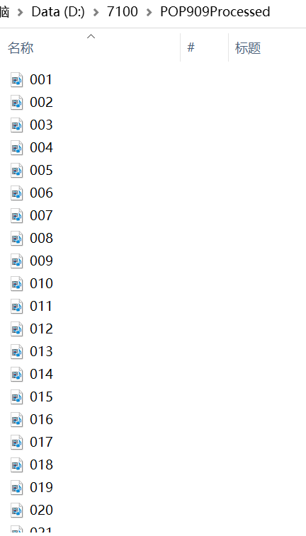
Processed POP909 completely

Slide 4
Processing LAKH
A video
Main Melody extracting process:
Two principles: 1. human always focus on the highest register; 2. human always focus on new notes, instead of the existing notes.
Problems:
Polyphony
The main melody is not in the high register, but hidden in the middle register, difficult to recognize.
Missing some very short notes
Solution for it(primary thinking):
Adding not only pitch detection but the instrument detection and dynamics detection.

Slide 5
Some questions about paper

Slide 6
Next week
Modify the Main Melody extracting method.
Process LAKH
Start to work on front end to process the input signal using FFT, noise tolerance, robustness, ect.
Continue to learn algorithum like DTW, UTW, LDTW etc, and try to code something to realize.

Slide 7
Thank you!

